Slide 1
TASTY NIGHTS
Its Never Too Late & We Proved It!

Slide 2
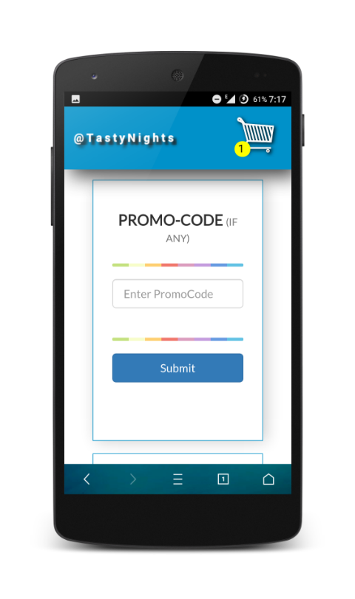
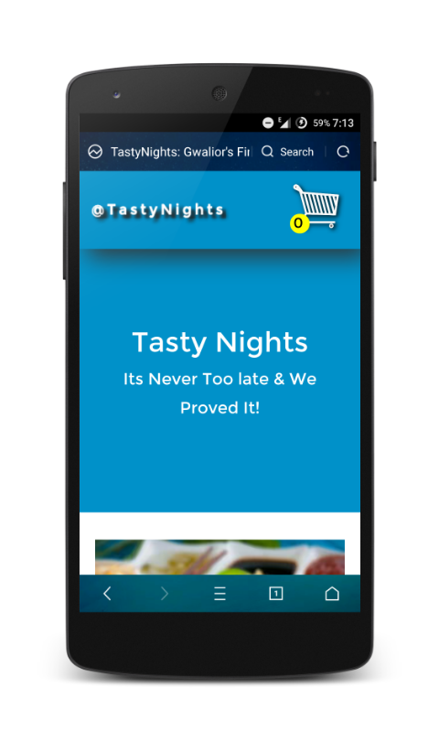
Its Never Too Late…
VISIT US ONLINE
(www.tastynights.in)
OR CALL US
(+91 9424386841)
Just,
ORDER
&
We Are Here For You!

Slide 3
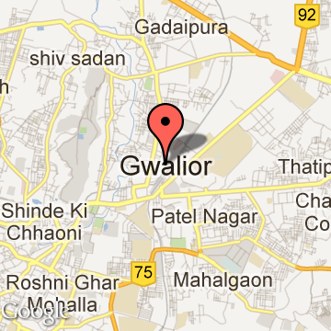
Who are we…
Tasty Nights is India's first late night food delivery startup operating in a tire 2 city.
We are currently operating in Gwalior, Madhya Pradesh and placing
20-30 ORDERS EVERYDAY.
We are serving tasty and quality food, we are getting good feedback from our customers.

Slide 4
What Makes Us Different
TIME
5 YEARS
We are the only Food Delivery Service in tire 2 city.
BRAND
CREATED
There is no need to have a heavy wallet for placing order at here.
We will deliver your food at your doorstep even if its a Rs. 100 order.
No Competition
Hence Easy TO Grow
. . . . . . . . . . . .
GWL
DELHI
Tier 2 Cities
Tier 1 Cities

Slide 5
Vision
Will place 50 orders per day in next 2 months
Have a target to place around 100 order in a 2 tire city per day and generating net profit of
before moving to another tire 2 city.
Will target another 2 tier city in next 5 months
2 LAKHS PER MONTH

Slide 6
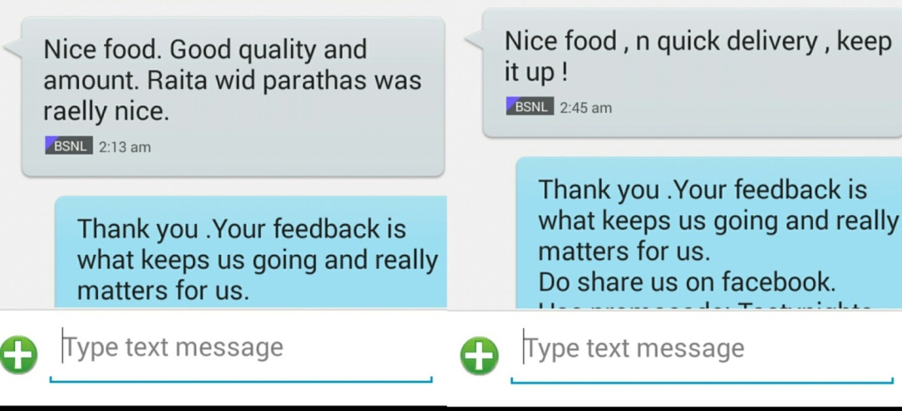
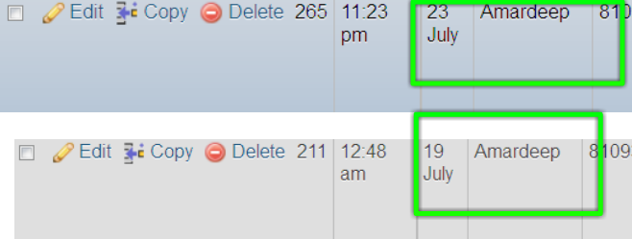
Our Customers
Our customers are also providing us their precious feedback, which help our startup to expand more.
Over these, our Happy Customers are ordering more than twice a week.

